Slide 1
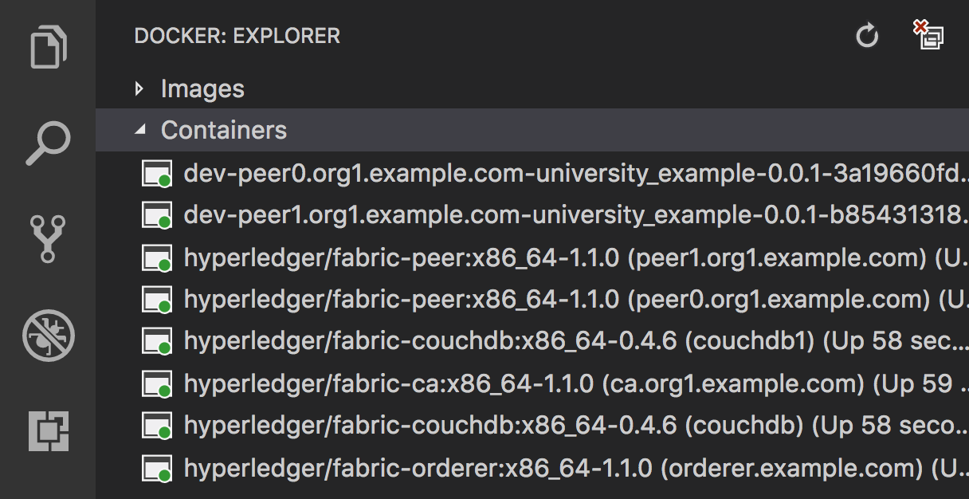
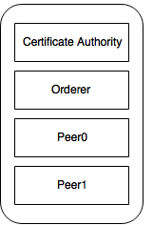
Adding Peer 1
Peer0 + CouchDB
Peer1 + couchDB1

Slide 2


Download binaries
Configure Scripts
Generate Crypto
Configure Docker Services
Peer Admin Card creation
Test the network
Download binaries
Configure Scripts
Generate Crypto
Configure Docker Services
Peer Admin Card creation
Test the network

Slide 3
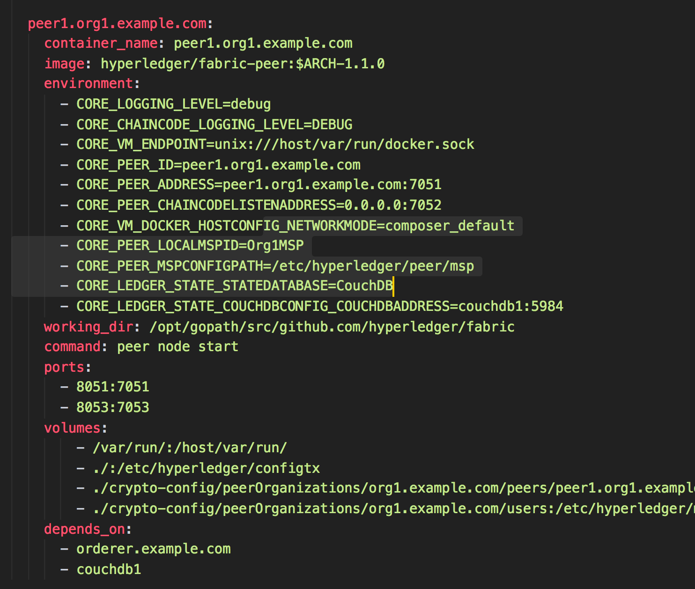

Slide 4
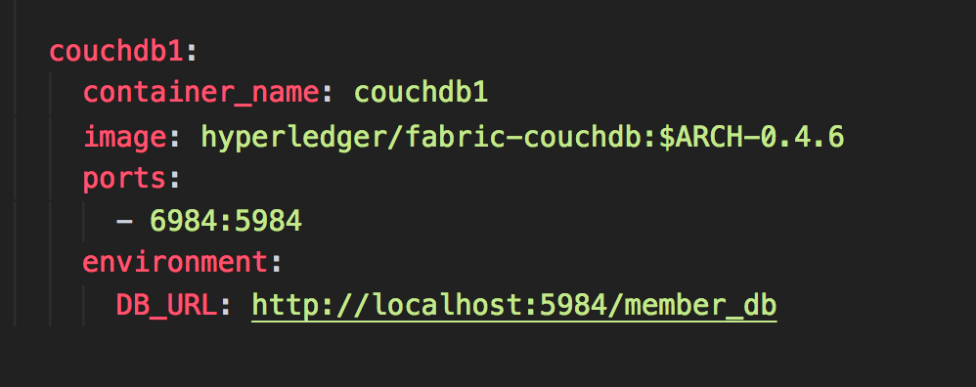

Slide 5
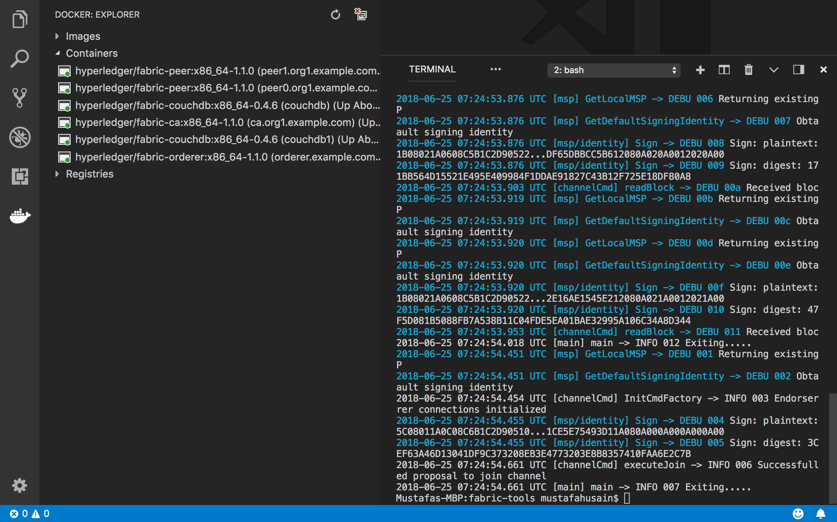

Slide 6
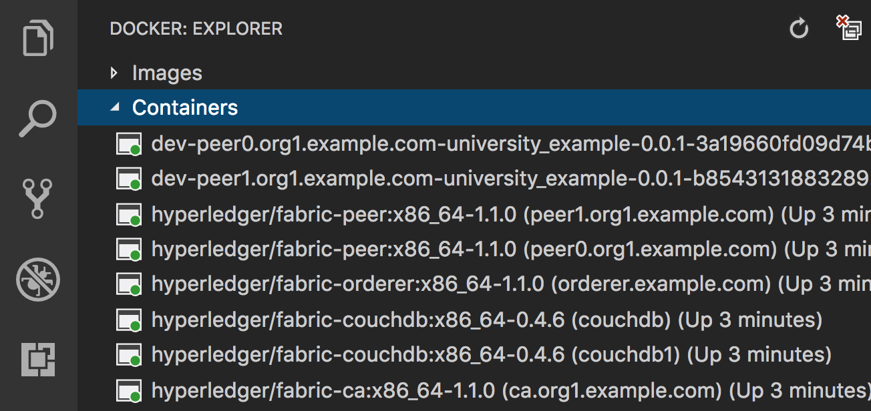

Slide 7
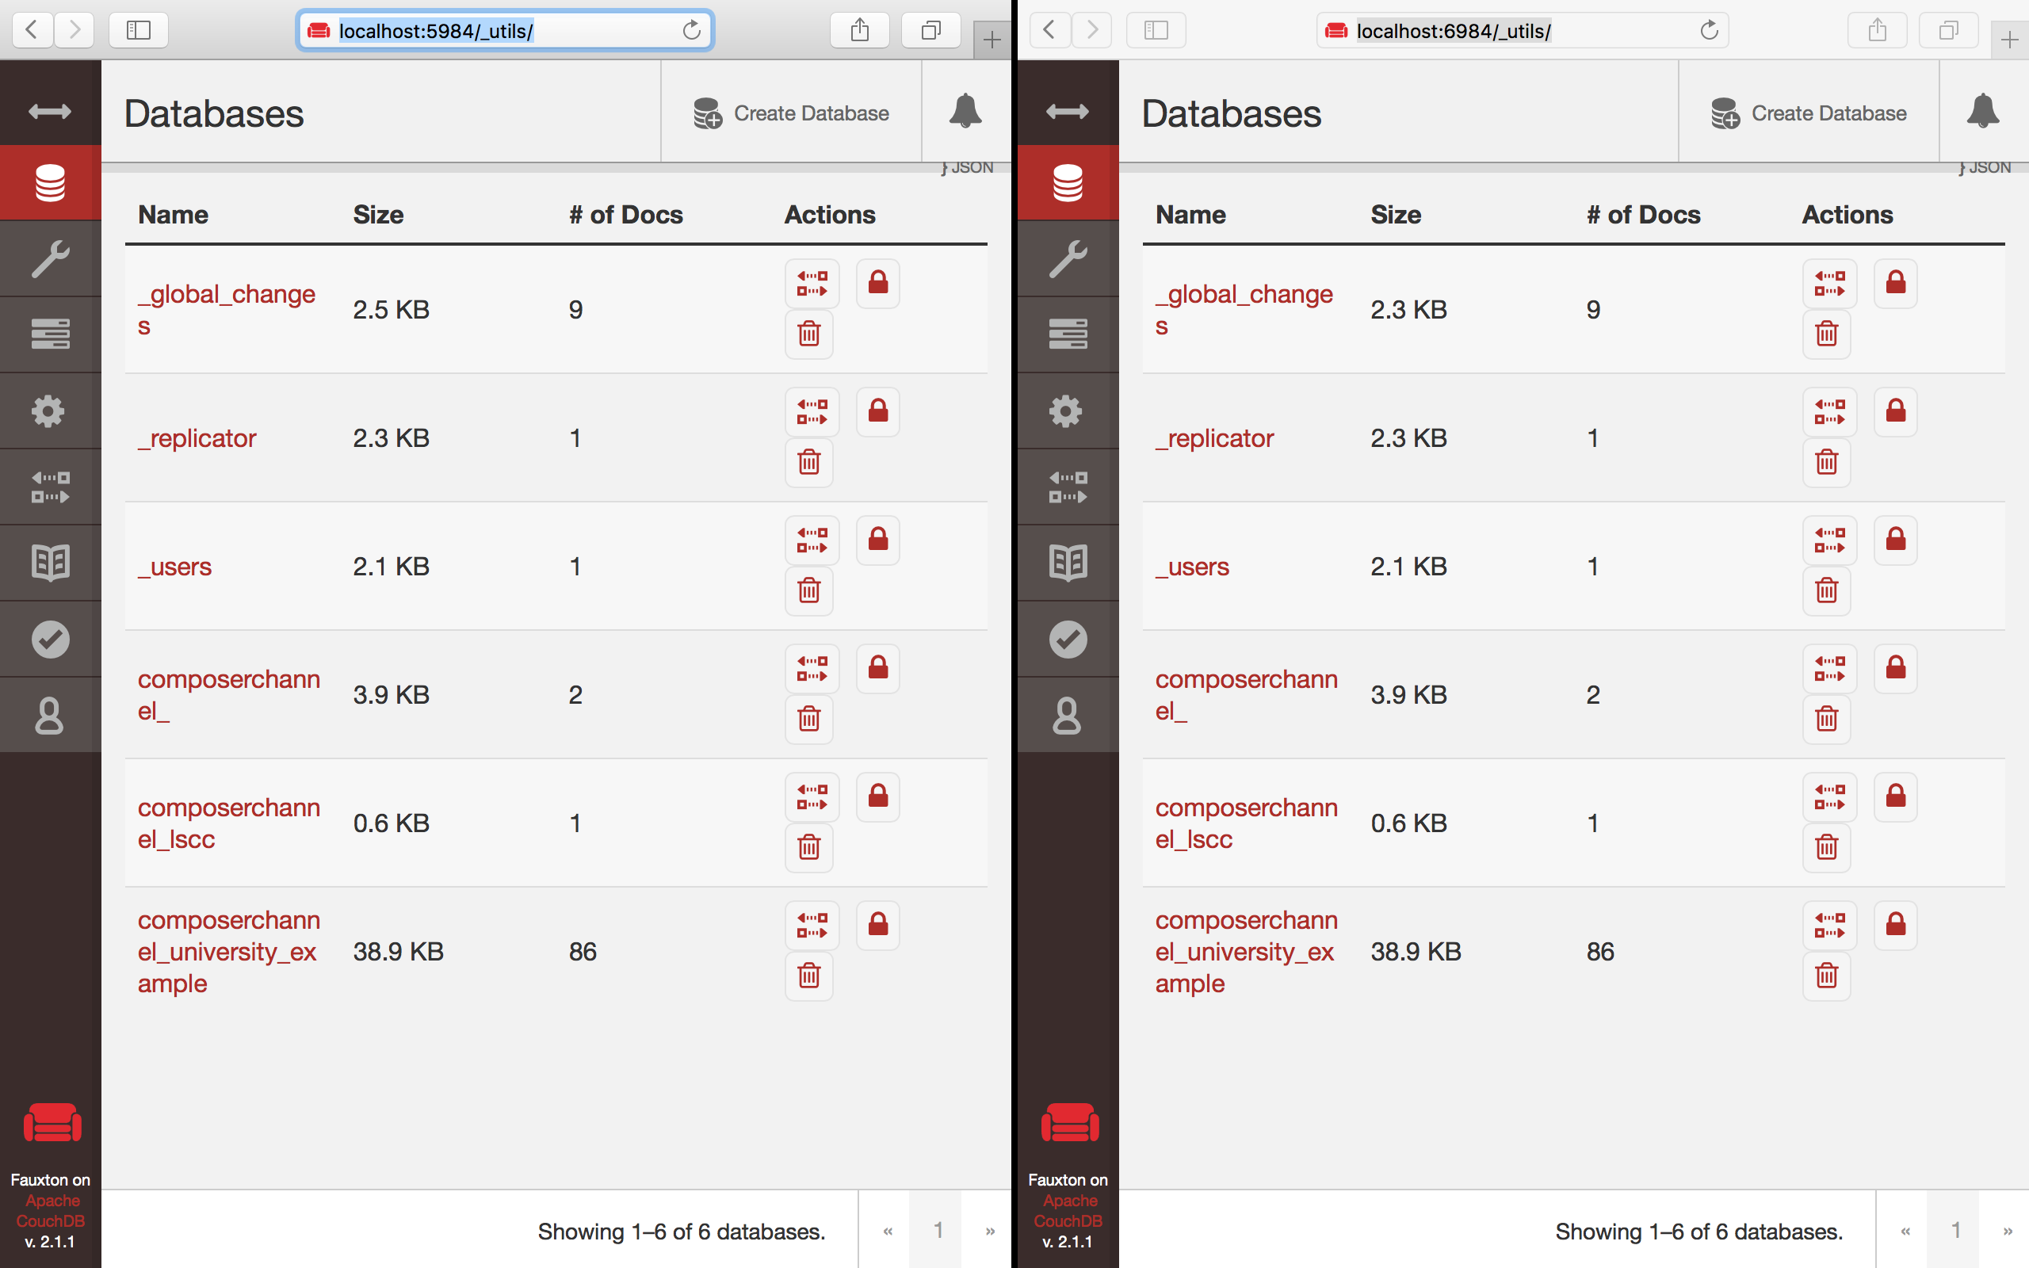

Slide 8
